Slide 1

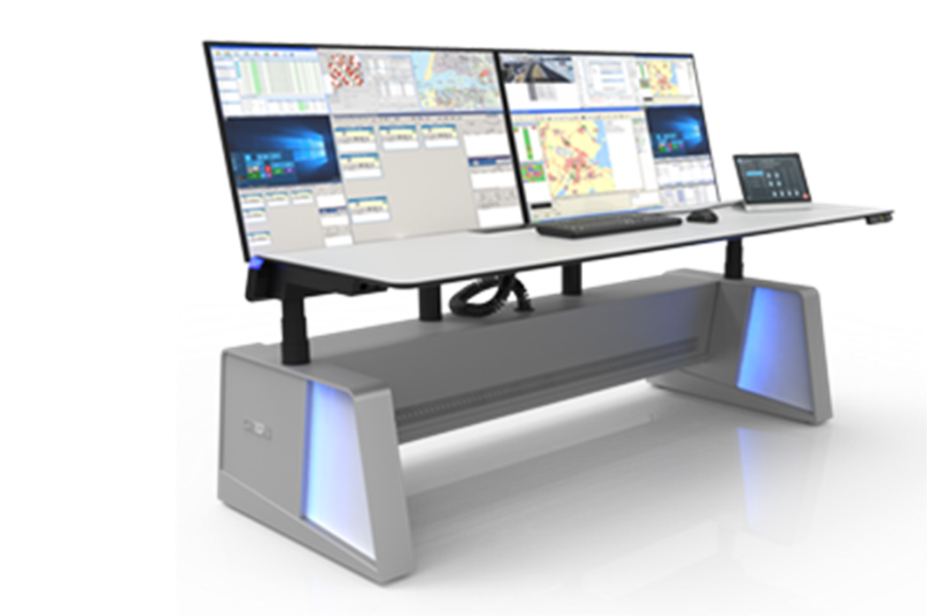
AI (ML) assisted Cybercapable ATSEP Working Position
for the Technical Supervision of CNS/ATM of the ANS Systems and Services
“ ARTIFICIAL INTELLIGENCE AND CYBER SECURITY IN CIVIL AND MiLITARY AVΙΑTION”
Flight Safety Foundation SE
30th of May 2024
LARNACA, Cyprus
Presented by:
Theodore Kiritsis
President
IFATSEA
email: president@ifatsea.org

Slide 2
IFATSEA
The International Federation of Air Traffic Safety Electronics Associations (IFATSEA) unites over 75 professional associations of Air Traffic Safety Electronics Personnel (ATSEPs) from around the world
  is the authoritative voice on the competence of air traffic safety electronics personnel.
  about 40,000 ATSEPs (Air Traffic Safety Electronic Personnel) globally
  Non political, Non industrial & Democratic
  Promote Safety & Efficiency in Aviation
  Contributes to the dvelopment of high standards CNS/ATM technologies
  Promotes ATSEP Skills, Knowledge & Professionalism
  Cooperate closely with international Aviation bodies

Slide 3
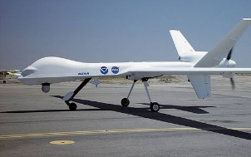
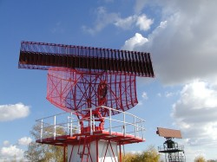
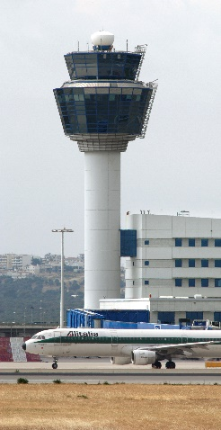
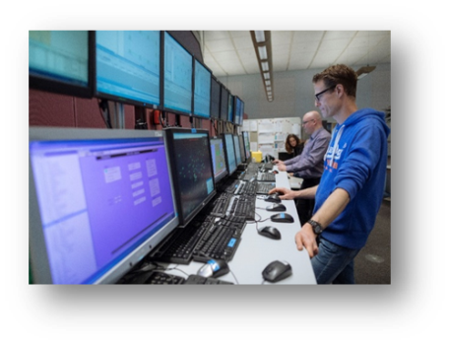

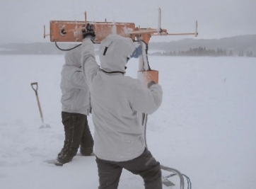
Definition of ATSEP
‘Air traffic safety electronics personnel (ATSEP)’ means any authorised personnel who are competent to operate,maintain, release from, and return into operations equipment of the Functional* system ;
‘*Functional system’ means a combination of procedures, human resources and equipment, including hardware and software, organised to perform a function within the context of ATM/ANS and other ATM network functions;
ATS
AIS
METEO
CNS/ATM
ATFM
ASM

Slide 4
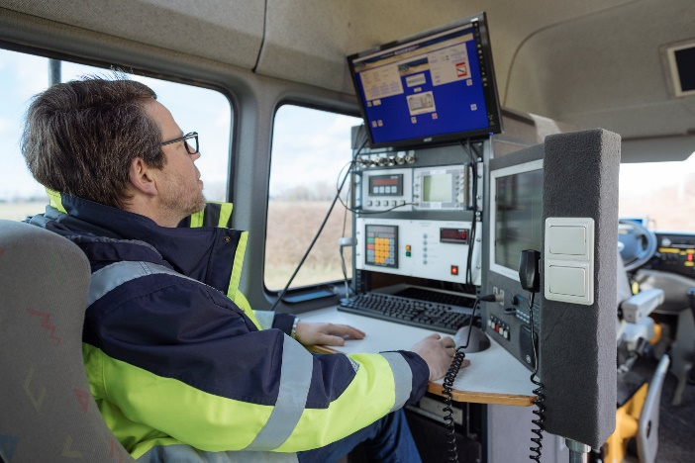

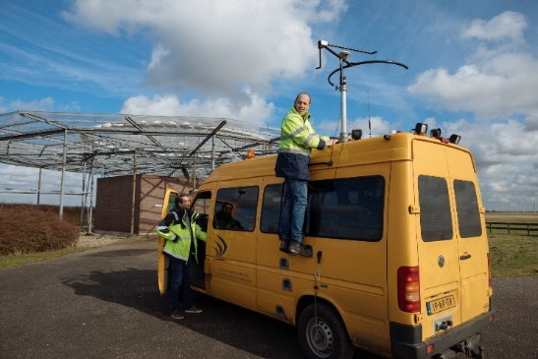

ATSEP TASKS(some) :

Slide 5

So, what happens in an ACC when we have a cyber attack?
who is the first responder ? -
  Tech Ops - ATSEP (possibly assisted by IT)
how do ATSEP diffentiate between a pure Technical failure contrary to a Technical failure due to a successful cyber attack?
  Do we have the necessary tools?
  do we have the procedures?
Do we have the necessary ATSEP Training?
Can AI help to prevent, detect and address Cyber attacks?
How can we adapt to new challenges?

Slide 6
  the ATSEP Role in Cybersecurity
  The ATSEP must (among other):
  distinguish whether any problem/degradation identified is a Technical failure or due to a Cyber event (space or Ground)
  respond to tactically address any cybersecurity issue
  ATSEP Sup to coordinate with the ATCO Sup locally or remotely in ATSUS of delegated airspace .
  mitigate degradatation so as to ensure CNS/ATM service continuity and speedy recovery
  Contributory factors-Scenarios
  Cybersecurity for ATM is complex and attack scenarios can be network attacks combined with attack (e.g spoofing) on the Signal in Space (spoofing and/or jamming) in order to create service disruptions (e.g airports) or safety degradation
  Changes to the CNS/ATM System Architecture (Remote Digital Towers, ADSPs , Virtual Centers) increase cyber vulnerability
  “the Human will need innovative AI assisted tools to resolve degradations”

Slide 7



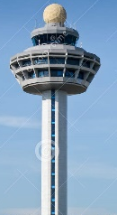
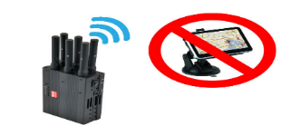
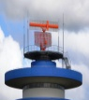
IFATSEA perspective - ATM Cyber Security
ADSP & Virtual Center-ATSU scenario
Airport scenario
(Tower or RT)
VIRTUAL CENTER 1 /ATSU1
Spoofing
Jamming
ATSEP WP
ATCO WP
ADSP
ATSEP WPs
ATCO ATSEP Tools?
ATSEP WP Bus
CNSP
VIRTUAL CENTER 2/ ATSU 2
SWIM Enabled Cloud
ATSEP WPs
SUR
COM
NAV/AIS/METEO
Other ADSPs
ATSEP WP
ATCO WP

Slide 8
Problem definition and proposal
in order to respond to AAS distributed architectures will need to rethink the issues of SMC (Systems Monitoring and Control) as there will be ATSEP on both sides of the border attending to systems that serve the same purpose (e.g. of providing data and services to ATSUs to a delegated airspace) and of course any risks that may rise in the area of Cybersecurity transversally over the ATM Data chain environments.
For example, imagine the situation where there is a ‘false target’ or spoofing issue identified the ATCO Supervisor in one country combind with a DoS attack while the ATSEP SMC Supervisor in charge of the sensors (and the ACC Data processing) in another country.
  How will the (cascaded?) failure root cause be identified and addressed ?
Addressing this cyber incident would be a challenge because AI assisted tools for shared awareness of security threat level and total system state and health awareness, have not been fully researched and developed yet.

Slide 9
Cyber security in CNS/ATM
A Technological Toolset for the ATSEP WP
IFATSEA proposes a Technical Supervision model instantiated in each ATSEP WP
“an event object mechanism assisted by AI, interfacing with individual systems (or Service providers (e.g. ATSUs , ADSPs ,SWIM, Datalink)), with predictive capabilities based on specific sensors activity monitoring (s/w and h/w) and displaying their health status in the SMC domain in real time”.
This architectural element will provide an interoperable ANSP (level) ANS systems status situational awareness with predictive capabilities , AI (ML) driven Cyber-Security capability, able to detect, clasiffy and propose solutions to pure technical or Cyber related degradations.

Slide 10
Principles of Concept design
The event effect must not reach the Controller or Pilot (if at all possible). (Note: Navigation info is transmitted directly to the pilot).
Cybersecurity events are treated tactically as any other technical event. These events are not only IT but may include physical elements such as ‘signal in space’ , spoofing ,RPAS , DoS, .
ATSEP on duty must have the tools and training to distinguish whether the event is technical failure or due to cybersecurity (*this will require research and standardization activity)
Cyber-attack vector and pattern recognition and analysis is done locally with the use of ML and further AI based techniques AND transversally

Slide 11

IFATSEA SMC-Cyber AI Concept for the ATSEP WP
3-Visualization,
Alerting
2-Decision Making
based on:
(BigData, Machine Learning,
ATSEP Experience)
1-Data aggregation
(messaging platform)
Total system situational awareness
AI Supervision
event
object
Cyber Sec Events
CNS/ATM Events

Slide 12
Impact on ATSEP Training
Training needed ( basic and on the job ) on cyber-attack / cyber-terrorism (EASA/ICAO ongoing) and AI Basics
  Develop ATSEP WP SIMULATORS (based on digital twins?) developed for ATSEP Training (including simulating Cross country coordination).
  Language requirement established for efficient communication beyond borders
  New recruitment procedures (background checks?). Carrer development for experts (Lack of ATSEP-interest of professonals/scientists/engineers)
  Increasing utilzation of Artificial Intelligence and clarification/elaboration of Human – Machine interdependencies

Slide 13
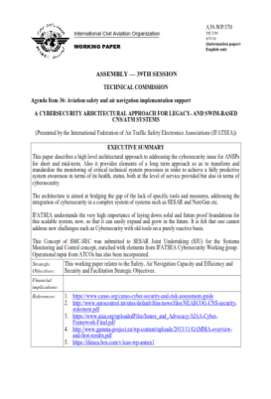
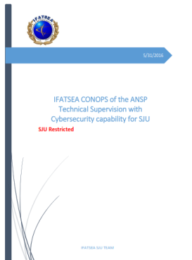
CONOPS dissemination
AI assisted Cyber-SMC Technical Supervision Concept presented to the ICAO Assembly 2016 as an IP under the title:
Agenda Item 36: Aviation safety and air navigation implementation support
“A CYBERSECURITY ARHCITECTURAL APPROACH FOR LEGACY- AND SWIM-BASED CNS/ATM SYSTEMS” , (A39-WP/370)
The concept was also presented to:
CONOPS description was also submitted to SJU
ICAO Cybersecurity working group
ENISA together with input for the ENISA study on Smart airports.
ICB as an input for the ICB Cybersecurity paper
EASA in 2018 in view of the Related regulatory work
EGHD as an integral part for the ATSEP WP
Activities in ICAO Training(NGAP) and also in AMC for ATSEP Training in EU 2017/373
Flight Safety Foundation SE - Cyprus 2023
FLY AI Forum Eurocontrol 2024

Slide 14
Some questions
Engineering : What is the maintainance concept of (safety critical) ANS applicaitons incorporating AI? (Hybrid applications)
Regulatory:
    since there is no SWAL Regulation in place any more (482/2007 on software safety assurence has been repealed, how to arrive at the related AI Assurance or Trustworthines (DAL?)?
    How and who will identify the possible AI failure modes effect analysis and their mitigations? Only ATS is required to have a SMS! (see EASA Concept paper-First usable guidance for Level 1 ML applications)
What procedures must be used for incident/accident data analysis?
  what kind of recording must be used (ML algorithm maturity system snapshot?)
  Lessons learnt after incidentanalysis would be only related to the level of ML algoritm maturity.
Can this be the elephant in the room?

Slide 15
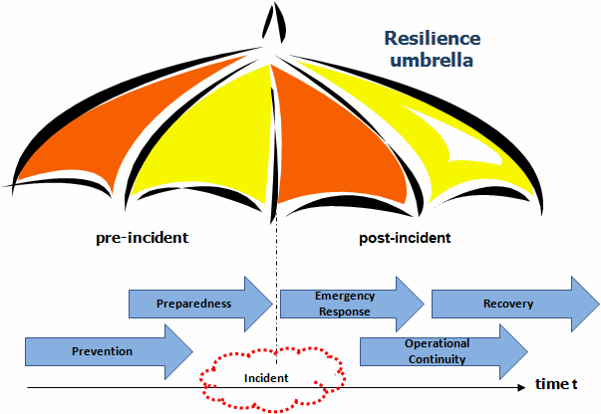
Thank you for your attention !
Any questions?

Slide 16
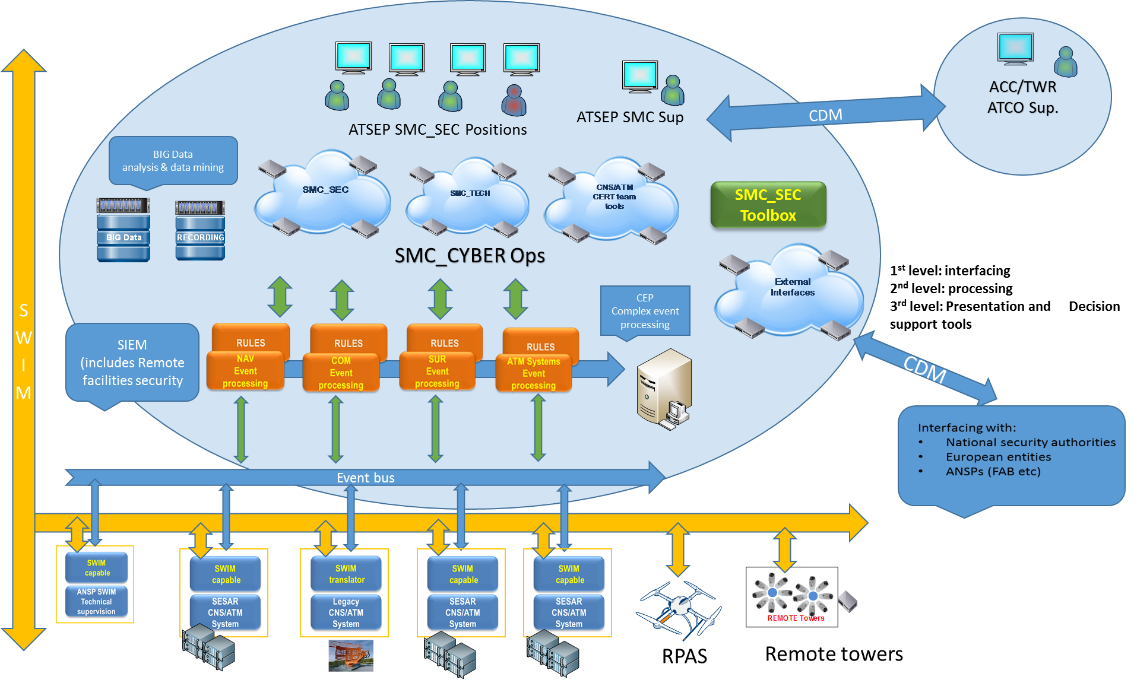
IFATSEA AI assisted SMC-Cyber Concept
ATSEP WP
3
2
1
ANSP SMC_SEC for SMC_CYBER Ops
Notes:
A cybersecurity related event, is considered as any other event, taking of course into account the type may be of a transversal nature, impacting more than one process or service in the ANS environment. (*….Cascade failures)
The system’s technical health events including Cyber events will feed a Complex Event Processing (CEP) engine being implemented at Local ANSP level in the Technical Department (CNS/ATM).
According to the Cyber and System’s health related predefined criteria(rules), the outcome of this CEP has to be treated accordingly and in any case as close as possible to real time.
Cyber threats or suspicious activities detected will be immediately (and proactively) addressed locally and communicated at a higher level (National) or further through to supranational entities.

